Slide 1

Round-Robin Scheduling in RTOS: An Overview
This presentation explores Round-Robin (RR) scheduling in Real-Time Operating Systems (RTOS). We'll cover its benefits, mechanics, and limitations. Target audience: Embedded systems developers, and students learning RTOS concepts.
by Dubba Naveen
DN

Slide 2
Understanding Real-Time Operating Systems (RTOS)
Definition
Characteristics
Examples
RTOS is designed for time-critical applications. The global real-time OS market is projected to reach $5.9 billion by 2028.
Key features include determinism, responsiveness, reliability, and efficiency.
Examples of RTOS include FreeRTOS, Zephyr, VxWorks, and QNX.

Slide 3
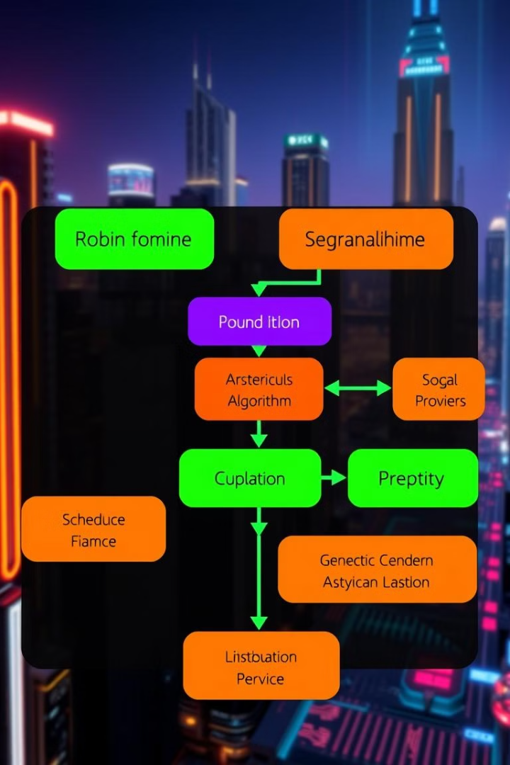




The Mechanics of Round-Robin Scheduling
Time Slice
Each task gets a fixed time slice (quantum).
Context Switch
Saving and restoring task states.
Ready Queue
Circular queue of runnable tasks.
Preemption
Interrupting a task when its quantum expires.

Slide 4

Advantages of Round-Robin
1
Fairness
2
Simplicity
3
Avoidance of starvation
Every task gets equal CPU time.
Easy to understand and implement.
No task is indefinitely blocked.

Slide 5

Disadvantages and Limitations
Priority Ignorance
Context Switching Overhead
Treats all tasks with equal priority. It potentially misses deadlines.
Can be significant if the time quantum is too small.
Not Ideal
Less efficient when tasks have different computational requirements.

Slide 6

Round-Robin in Real-Time Systems: Considerations
1
Optimal Time Quantum
Determining the optimal time quantum for real-time tasks.
2
Priority Levels
Incorporate priority levels: Weighted Round-Robin or hybrid approaches.
3
Task Synchronization
Mechanisms to prevent race conditions.

Slide 7




Practical Examples and Use Cases
Embedded systems: Scheduling tasks in a microcontroller-based system.
Industrial automation: Controlling robotic arms or conveyor belts.
Network routers: Fairly distributing bandwidth among users.

Slide 8

Conclusion: A Foundation for RTOS Scheduling
Round-Robin is a foundational scheduling algorithm in RTOS. Its strengths include simplicity and fairness. Its limitations in real-time contexts should also be considered.

